Slide 1
JPX Stock Exchange
A Time-Series Project
Predicting the Sharpe Ratio of Stocks
Jim Petoskey
Flatiron School
Capstone Project

Slide 2
Outline
Business Opportunity
Summary
Data
Methods
Results
Conclusions
Further Study

Slide 3
Business Opportunity
JPX Stock Exchange – Increase Trading
Increase trading to increase revenue
Provide institutional investors with machine learning models that predict daily stock direction.

Slide 4
Summary
It is possible to predict the daily direction of stocks from the Sharpe Ratio.
Machine Learning Models make it possible to accurately predict stock direction and accrue returns when stocks are bought and shorted at scale.
Returns are generated by buying 200 and shorting 200 stocks on a daily basis.
Sharpe Ratio is predicted on a given day, then:
Stocks are bought at the close of the following business day and sold at close the day following that.

Slide 5
Data
2000 stocks with 4.5 years of data
Data from additional stocks provided to improve modeling
Financial Data Utilized
Trading Information, Income Statements, Market Sector, Issued Shares,
New Information Produced – 12 Features
Improvised Sharpe Ratio, Daily Return, Weekly Moving Average, etc.

Slide 6
Methods
Find best method of modelling data to predict Sharpe Ratio
Use ARIMA, LSTM Neural Network, and Random Forest Regressor
RMSE used as method for calculating error and comparing models.
Model Forecast predicts Sharpe Ratio on daily basis
Sharpe Ratio prediction greatly enhanced by calculating an expected Sharpe Ratio using Sharpe’s equation for Ex-Post Sharpe Ratio.

Slide 7
Results Summary
Most volatile stock’s predictions shown for each model.
ARIMA Model
Prophet Model
Not elaborated upon as very similar to ARIMA
LSTM Neural Network Model
Random Forest Regressor – 1 Model for all Stocks
Random Forest Regressor – Individually Modelled
RMSE Plot and Kaggle Scores Presented

Slide 8
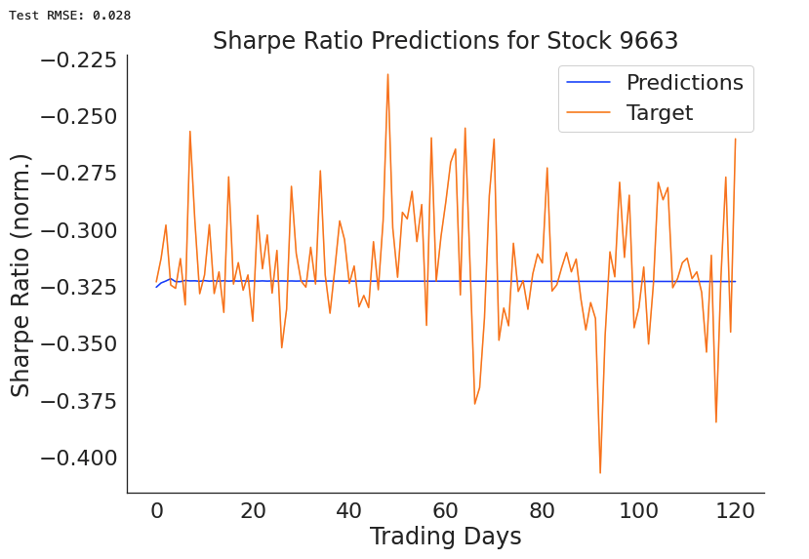
Results ARIMA Model
ARIMA had a low Kaggle score of -1.43.
Model predicted near the mean because it could not determine any pattern, trend, or seasonality to follow.

Slide 9
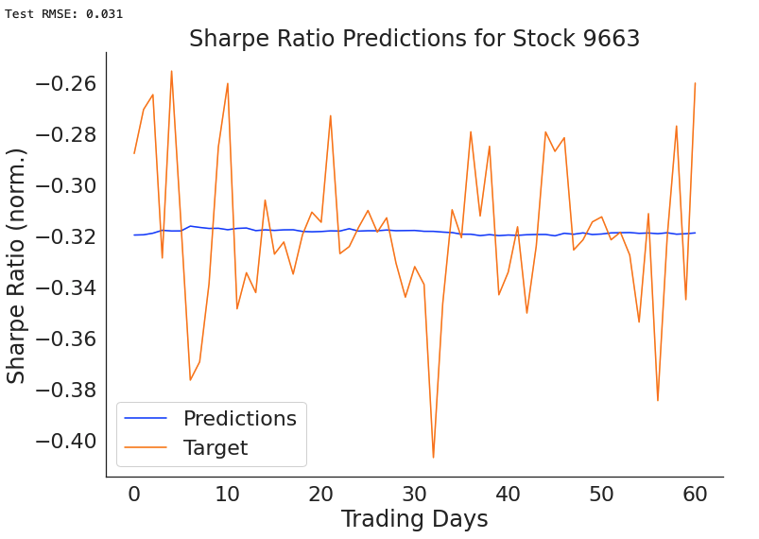
Results LSTM Model
LSTM was not scored due to high computational expense.
Likely would have scored similarly to the ARIMA model due to similar predictions for each stock.
Model predicted near the mean – likely because this was the best way to lower error.

Slide 10
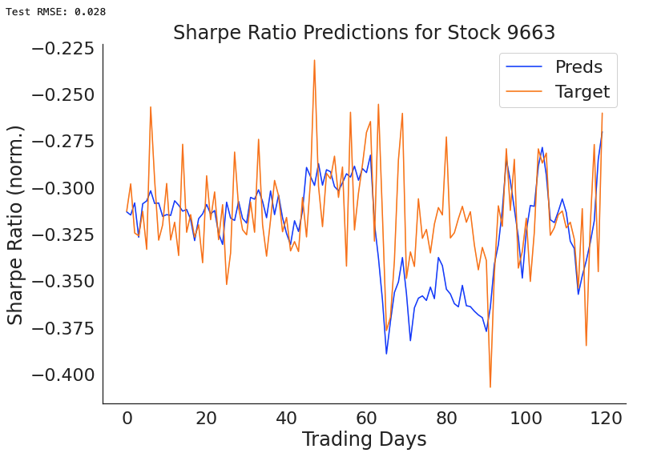
Results Single Random Forest Regressor Model
Model predicts much further away from the mean with similar or less error than ARIMA or LSTM
Improvised Sharpe Ratio calculation most important feature.
Nearly 4 times as important as next most utilized feature.

Slide 11
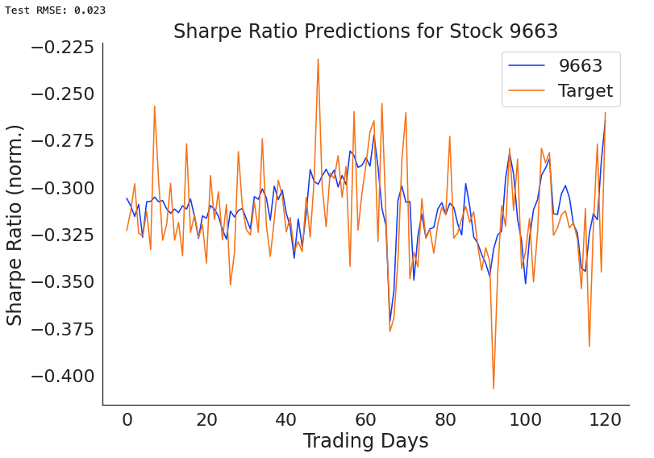
Results Individual Random Forest Regressor Models
Model with least error for Stock 9663.
Illustrates how predicting volatile stocks important for differentiating between stocks’ Sharpe Ratio.
Predictions clearly much better than previous Random Forest Regressor between days 65 – 90.

Slide 12
Results

Slide 13
Results

Slide 14
Conclusions
Institutional Investors and Retail Investors, in some cases, will be able to profit from daily investing at a large scale.
Important to understand that a large portfolio minimizes risk.
Increased trading on JPX Stock Exchange likely
Random Forest Regressors are producing positive returns.
Increasing revenue likely for JPX Stock Exchange due to competition.
Recommend creating relationships between data scientists in competition and institutional investors.

Slide 15
Future Work
Add Options Data
Information leading to model interpretation of Sharpe Ratio important
Need to test whether options information can improve predictions.
Test Additional Regressor Model Types
Bayesian Regressors thought to be strong stock market model types.
Further Investigate Neural Networks
.Many Neural Networks with options for layers are possible
Want Neural Network that risks predictions further from mean

Slide 16
Questions & Answers
Contact Information:
Jim Petoskey – Data Scientist
Jim.Petoskey.146@gmail.com
Phone: (734) 649-3182
linkedin.com/in/jimpetoskey/

